Slide 1

Regression Discontinuity Design in The Impact of Precalculus on Student Success at Florida Polytechnic University: A Study of the Initial Academic Year (2017-2018)
By: Gus and Hail
Moral Support: Hail

Slide 2

What was the design?

Slide 3
Two Paths Into Calculus
Come in with college Calculus 1 credit
Take the ALEKS test
Score >= 71 and take Calculus 1
Score < 71 and take Pre-calculus

Slide 4
Two Paths Through First Year
Take Pre-calculus
Pass/Fail
Pass: Take Calculus 1
Fail: Take Pre-calc again
Worst case 2nd year in pre-calc for a 3rd time. 1.5yrs behind in progression.
Calculus 1
Pass/Fail
Pass: Take subsequent courses
Fail: Take Calc 1 again
Worst case 2nd year in calc 1 for a 3rd time. 1 year behind in progression.

Slide 5
Regression Discontinuity Design (RDD)
RDD is used to determine the causal effects of a treatment by assigning a cutoff above or below the assigned treatment or intervention.

Slide 6
Average Treatment Effect (ATE)
Compares treatments in randomized experiments
Comparing the observations that are really close to either side of the cutoff point can allow us to estimate the difference in the average outcomes between the treated and the control groups.

Slide 7
Intention to Treat
The internal validity of the RDD is compromised when there is noncompliance with treatment assignment based on the pretest.
This can be addressed by using intention to treat rather than just treatment and control.

Slide 8
Intermission

Slide 9
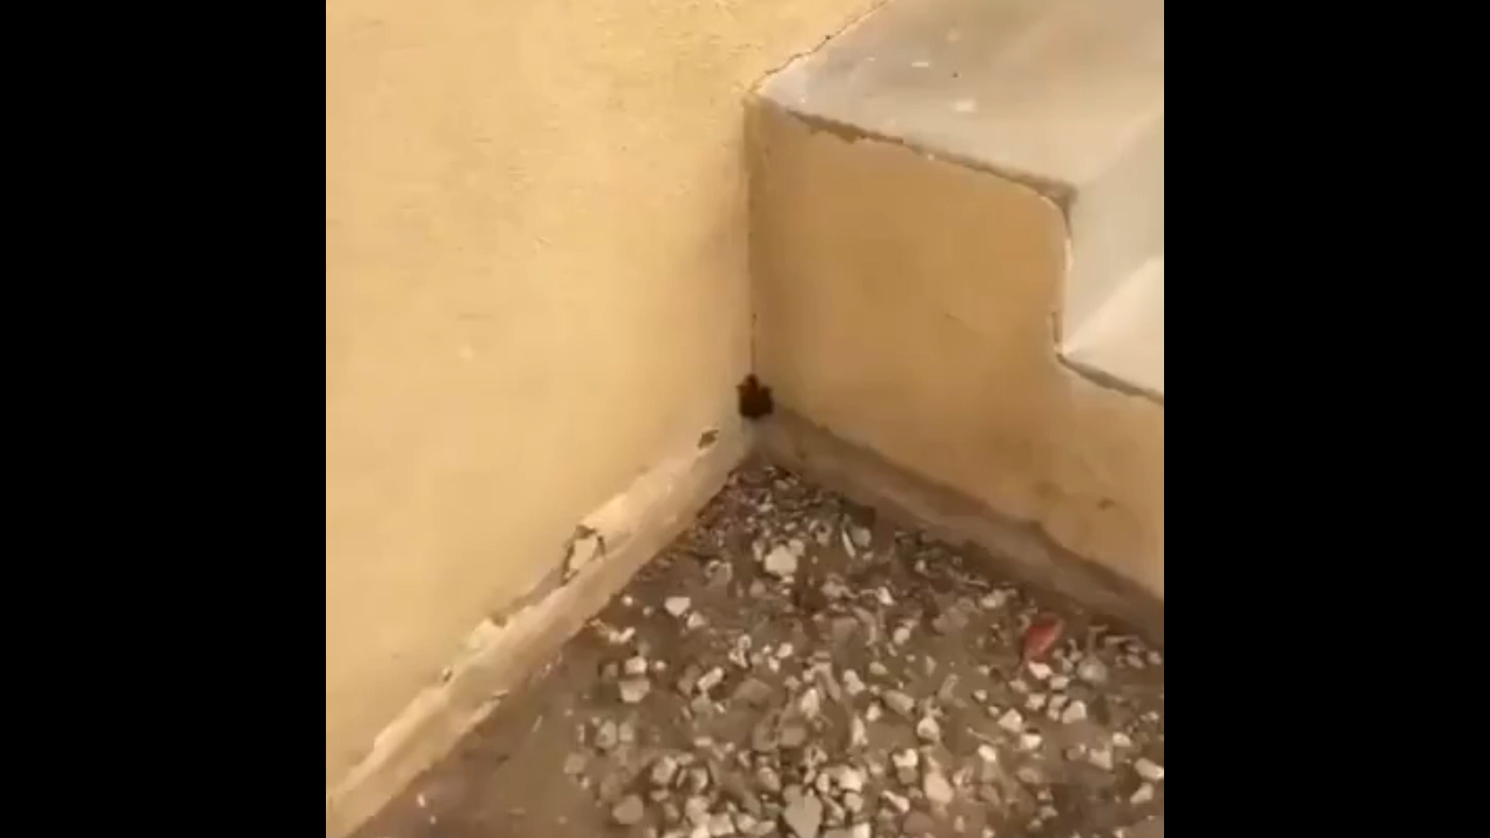

Slide 10
Was it fuzzy?

Slide 11
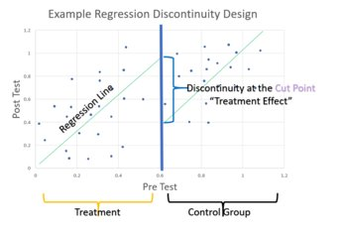
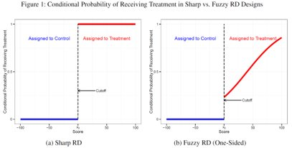
“This study uses a fuzzy regression discontinuity design”
Powell, M. (2020). The Impact of Precalculus on Student Success at Florida Polytechnic University: A Study of the Initial Academic Year (2017-2018) (thesis).

Slide 12
What is the result?

Slide 13
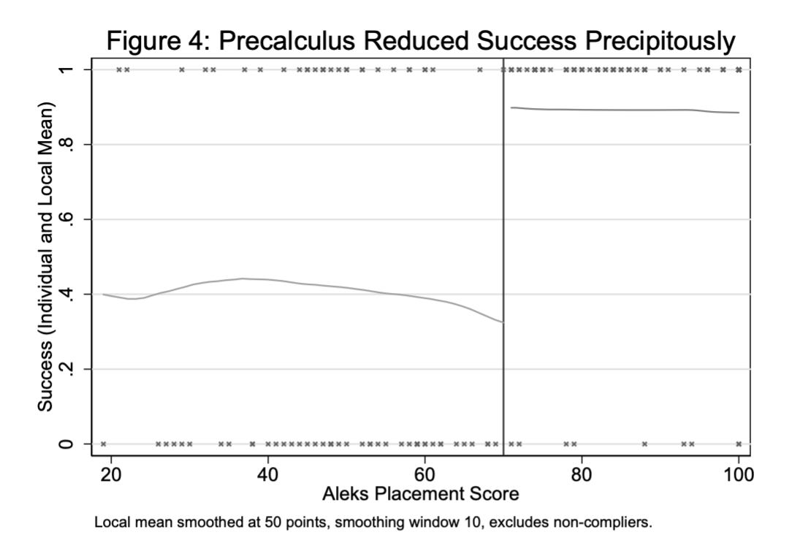
Primary Analysis
Precalculus Reduced Success
If a student was placed in pre-calc based off their ALEKS score, their probability of completing Calc 1 by the end of 1st year was reduced by 0.5 with a standard error of 0.145

Slide 14
Secondary Analysis
Quantify the potential role of peer effects
This impact can be largely accounted for by two mechanisms:
Peer effects
Adding Precalculus poses more hurdles prior to Calculus and reduces the number of chances to pass Calculus.

Slide 15
Q&A
By: Gus and Hail
Moral Support: Hail

Slide 16
Answers
Jake: A new wardrobe brings great joy and change to your life
Maverick: Do not upset the penguin today
Kori: If you feel you are right, stand by your convictions
Graham: You learn from your mistakes… You will learn a lot today

Slide 17
Answers
Logan: It never pays to kick a skunk
Nicole: Move quickly, now is the time to make progress
Hail: Eat more vegetables to stay healthy
Dr Dewey: Nothing astonishes men so much as common sense and plain dealing.

Slide 18
Regression Discontinuity Design in The Impact of Precalculus on Student Success at Florida Polytechnic University: A Study of the Initial Academic Year (2017-2018)
By: Gus and Hail
Moral Support: Hail

